Slide 1
STATE AND LOCAL ISSUES FORUM
SEPTEMBER 12, 2024
Matthew Hargrove, CEO
California Business Properties Association
mhargrove@cbpa.com

Slide 2
ABOUT
CBPA
CBPA is the voice of the office, industrial, and retail real estate industry in California - Protecting the interests of over 10,000 members in front of the Legislature and regulatory agencies for over 50 years.
CBPA.COM

Slide 3
ABOUT
CBPA
50 Years of Service
Governor Newsom Recognizes CBPA
CBPA.COM

Slide 4
REMEMBERING REX
Rex S. Hime
Founding CEO and President Emeritus
February 15, 1948 - February 4, 2023
CBPA.COM

Slide 5
KEY ISSUES
Supply Chain,
Logistics,
Warehouses
Infrastructure
Development
Tax Reform,
Proposition 13
Retail
Theft
Economic
Competitiveness
ADA Reform
CEQA,
Land Use
Landlord,
Tenant
Water and
Energy

Slide 6
2024 LEGISLATIVE SESSION
2,124 Bills Introduced
Over 400 with Potential Impact to Commercial Real Estate
200+ bills advocated on by our industry
CBPA.COM

Slide 7
AB 2433 - PRIVATE PERMITTING REVIEW AND INSPECTION ACT - DEAD
AB 2433 (Quirk-Silva; D-Fullerton) is sponsored by CBPA and NAIOP of CA
Improves the building permit process to expedite projects. Introduces flexible fee structures, expedited inspection timelines, and conditional employment of external professional services.
Withdrawn by author due to SEIU opposition
CBPA.COM

Slide 8
ADDITIONAL SPONSORED BILLS
AB 2904 (Quirk-Silva; D-Fullerton) Zoning Notice -
ON GOVERNOR’S DESK
Changes current law by requiring a longer notice period of 60 days to be given to property owners before a public hearing is held on a proposed zoning ordinance or amendment.
AB 3196 (Nguyen; D-Elk Grove) - Demurrer Hearing Timetable - DEAD
Enhances efficiency of legal processes in commercial property disputes. By setting a definitive schedule for demurrer hearings, it will reduce delays and financial hardships faced by small property owners and new small businesses.

Slide 9
RETAIL THEFT BILLS
Legislative Package Supported By Industry - SIGNED INTO LAW
AB 1779 (Irwin, D) Theft: jurisdiction - This bill allows theft cases to be prosecuted by any district attorney with evidence and mutual agreement.
AB 1802 (Jones-Sawyer, D) Crimes: organized theft - This bill extends the crime of organized retail theft indefinitely.
AB 1972 (Alanis, R) Regional property crimes task force - This bill extends the mandate of the regional property crimes task force to support railroad police and combat cargo theft.
AB 2943 (Zbur, D) Crimes: shoplifting - Assembly leadership comprehensive retail theft measure.
AB 3209 (Berman, D) Crimes: theft: retail theft restraining orders - This bill allows courts to issue restraining orders against repeat retail theft offenders.
SB 905 (Wiener, D) Crimes: theft from a vehicle - This bill imposes stricter punishments for breaking into locked vehicles and possessing stolen property with intent to sell.
SB 982 (Wahab, D) Crimes: organized theft - This bill makes organized retail theft a permanent offense.
SB 1144 (Skinner, D) Marketplaces: online marketplaces - This bill closes a loophole allowing third-party sellers to avoid verification requirements by using offline payment methods.
SB 1242 (Min, D) Crimes: fires - This bill adds enhanced penalties for arson committed during organized retail theft.
SB 1416 (Newman, D) Sentencing enhancements: sale, exchange, or return of stolen property - This bill introduces sentencing enhancements for selling or returning stolen property from retail businesses.

Slide 10
ADAPTIVE REUSE - SUPPORT
AB 2243 (Wicks; D-Oakland) - Adaptive Reuse Incentives
ON GOVERNOR’S DESK
Expands and modifies provisions of the Affordable Housing and High Road Jobs Act of 2022.​
​
Focuses on allowing residential development on commercial sites and​ provides certain incentives.​
​
Expands definition of retail site that can qualify.

Slide 11
ADAPTIVE REUSE - SUPPORT
AB 3068 (Haney; D-San Francisco) - Adaptive Reuse Incentives
ON GOVERNOR’S DESK
Aims to promote the conversion of existing nonresidential buildings into residential or mixed-use spaces by allowing cities and counties to offer financial incentives for adaptive reuse projects and streamlining the approval process for converting.
AB 2910 (Santiago; D-Los Angeles)
ON GOVERNOR’S DESK
Conversion of Commercial or Industrial Buildings
Aims to leverage underutilized commercial buildings for residential use to facilitate the conversion of commercial or industrial buildings into residential units. Allows pro-housing jurisdictions with compliant housing elements to adopt alternative building regulations.

Slide 12
AB 2550 - EMPOWERING SMALL BUSINESSES - SUPPORT
ON GOVERNOR’S DESK
AB 2550 (Gabriel; D-San Fernando Valley) supports small businesses by modernizing regulations, reducing "dead rent" periods, and alleviating financial pressures. This legislation is especially important for brick-and-mortar businesses, particularly in food service, which continue to face immense economic pressures from the lingering impacts of COVID-19 and inflation.
CBPA supported and proudly helped draft
the bill language.

Slide 13
AB 98 - SEVERE WAREHOUSE LIMITATIONS - PRIORITY OPPOSE
ON GOVERNOR’S DESK
AB 98 (Carrillo; D-Palmdale and Reyes; D-San Bernardino) Imposes statewide mandates on warehouse locations and operations, overriding local control. It requires buffer zones, truck route restrictions, and zero-emission vehicle standards.
Introduced as a gut and amend just days before the end of the legislative session, the bill passed the Legislature despite heavy opposition.
CBPA.COM

Slide 14
SB 1103 - COMMERCIAL LEASE MANDATES - PRIORITY OPPOSE
ON GOVERNOR’S DESK
SB 1103 (Menjivar; D-Van Nuys) would disrupt the commercial leasing landscape by imposing requirements detrimental to both property owners and the small businesses and nonprofits this bill aims to protect.
This bill would lead to increased legal risks, uncertainty, administrative burdens, and costs due to the documentation and translation requirements.
CBPA.COM

Slide 15
JANITORIAL MANDATES - OPPOSE
AB 2364 (Rivas; D-Los Angeles) - Unrealistic Janitorial Quotas
ON GOVERNOR’S DESK
Threatens to create a bureaucratic nightmare, transforming the janitorial industry with unrealistic cleaning quotas and skyrocketing costs for employers. By establishing a Council similar to the controversial Fast Food Council, this bill undermines flexibility and disproportionately targets non-union employers, paving the way for costly lawsuits.
AB 2374 (Haney; D-San Francisco) - Costly Custodian Mandates - DEAD
Would transform the Displaced Janitor Opportunity Act into a joint liability statute under which any size company becomes liable for the failure of a contractor to comply with the Act. Would be burdensome and result in higher operating costs.

Slide 16
2024 BALLOT MEASURES
Proposition 2 - SUPPORT
$10B School Facilities Bond
Proposition 3 - NO POSITION
Proposition 8 Repeal
Proposition 4 - NO POSITION
$10B Climate Bond
Proposition 5 - OPPOSE
Reduces Two-Thirds Vote Threshold
Proposition 6 - NO POSITION
Ban Mandatory Prison Labor
Proposition 32 - OPPOSE
$18/hr Minimum Wage
Proposition 33 - OPPOSE
Rent Control
Proposition 34 - SUPPORT
Restricts Political Spending by Healthcare Foundations
Proposition 35 - NO POSITION
MCO Tax
Proposition 36 - SUPPORT/ENDORSED
Retail Theft/Prop 47 Reform

Slide 17
PROP 5 - OPPOSE​
Makes it Easier to Raises Taxes on Property Owners by Lowering Bond Vote to 55%
Continues to Erode Prop 13/Prop 218 by lowering Vote Threshold.​
​
Bonds are paid exclusively by property owners​
​
Expands what local governments can use bond proceeds for​
to include ongoing operational costs.
CBPA.COM

Slide 18
PROP 36 - SUPPORT
THE HOMELESSNESS, DRUG ADDICTION &
THEFT REDUCTION ACT BALLOT INITIATIVE
Reclassifies retail theft with two or more prior convictions as a felony.
After two hard drug convictions, discretion to charge third hard drug
possession as treatment mandated felony.
Address fentanyl crisis by going after fentanyl drug dealers.
CBPA.COM

Slide 19
SUPPORTED MEASURES
Proposition 2 - SUPPORT - $10B School Facilities Bond
This $10 billion bond measure is aimed at funding repairs and upgrades for thousands of K-12 school and community college buildings across California. Under this plan, K-12 schools will receive $8.5 billion, while $1.5 billion will be allocated to community colleges. This measure would encourage much needed development in California and enhance our state's economic competitiveness.
Proposition 34 - SUPPORT - Restricts Political Spending by Healthcare Foundations
This measure would mandate that specific healthcare providers allocate almost all funds from a federal prescription drug program towards patient care. It would forbid the AIDS Healthcare Foundation from using the organization’s coffers to advance a political agenda through the ballot, and ensure public tax dollars meant for patients are spent on patients.

Slide 20
OPPOSED MEASURES
Proposition 32 - OPPOSE - $18/hr Minimum Wage
This measure would raise the state minimum wage from $16 to $18. California's minimum wage has rapidly increased over the last several years, and higher minimum wages have been established for fast food and health care workers. Another increase would further threaten the economic competitiveness of our state and drive businesses out of California.
Proposition 33 - OPPOSE - Rent Control
This measure would permit local governments to enforce rent controls. It would repeal the Costa-Hawkins Rental Housing Act that generally prohibits cities and counties from imposing rent limits on properties occupied after February 1, 1995. Proposition 33 would have an adverse impact on property values and the economic competitiveness of California.

Slide 21
CBPA Serves as Co-Chair
Restores Protections under Prop 13
Removed from ballot by Supreme Court
Gives voters the final say on all new and higher taxes
Requires all new taxes passed by the Legislature to be approved by voters and restores two-thirds voter approval for all new local special tax increases.
Eliminates all “hidden taxes”
Clearly defines what is a tax or fee — addressing recent court decisions that overturned decades of established taxpayer protection,
Requires truthful descriptions of new tax proposals
Holds politicians accountable by requiring they clearly identify how revenue will be spent before any tax or fee is enacted and ensures it is not diverted to other purposes.
ACA 13 - Measure to derail TPA - removed from 2024 ballot

Slide 22
PRIVATE ATTORNEYS
GENERAL ACT (PAGA)
Deal Negotiated to Avoid Ballot Measure
Authorizes aggrieved employees to file lawsuits to recover civil penalties on behalf of themselves, other employees, and the State of California for Labor Code violations.
Went into effect in 2004 - lawsuits have increased by over 400 percent between 2005 and 2013.
In June, the governor, legislative leadership and business and labor groups announced an agreement on needed reforms to PAGA that avoids a ballot measure campaign. The agreement aims to strengthen worker protections, encourage employer compliance, and streamline litigation processes.
CBPA.COM

Slide 23
GRANTS PASS V. JOHNSON
HOMELESS ENCAMPMENT CASE
In June, the U.S. Supreme Court ruled that cities can enforce bans on homeless people sleeping outdoors, even when there is a lack of adequate shelter space.
The ruling has been praised as a necessary step to address public safety and sanitation concerns created by illegal camps on city streets and private property.
CBPA and the Pacific Legal Foundation filed a brief in this case, given the negative impact this issue has on the commercial real estate industry.
CBPA.COM

Slide 24
CBPA PAC
CBPA Maintains an Issues PAC and a Candidates PAC and so far in the 2023-2024 Campaign Cycle the Issues PAC has raised $315K and spent $80K on the following:
StopTheCopTax (S.F)
Competitive Edge (SD Transfer Tax Poll)
Taxpayer Protection Act
Retail Theft Initiative
The CBPA Candidates PAC has raised $290K and spent $145K:
Supported 16 assembly candidates
(10 Dem/6 Reep)
Supported Governor Newsom
Supported Republican Leadership
Supported Assembly Moderate Caucus
L.A. Jobs PAC
Speaker Rivas Leadership Acct
Sen. Blakespear Legal Defense
Dixson/Gallagher Leadership
L.A. County - Barger for Supervisor

Slide 25
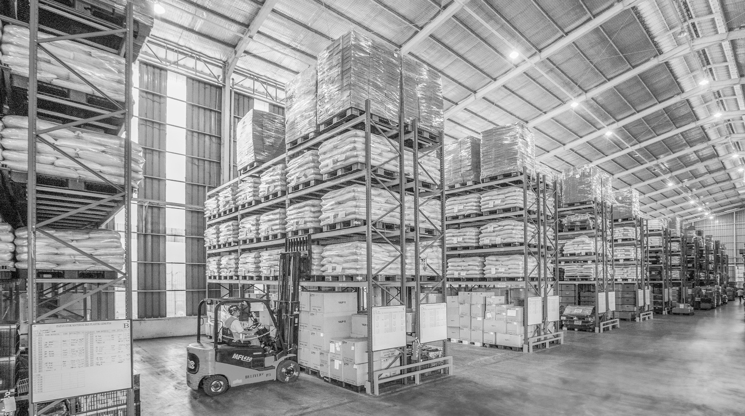
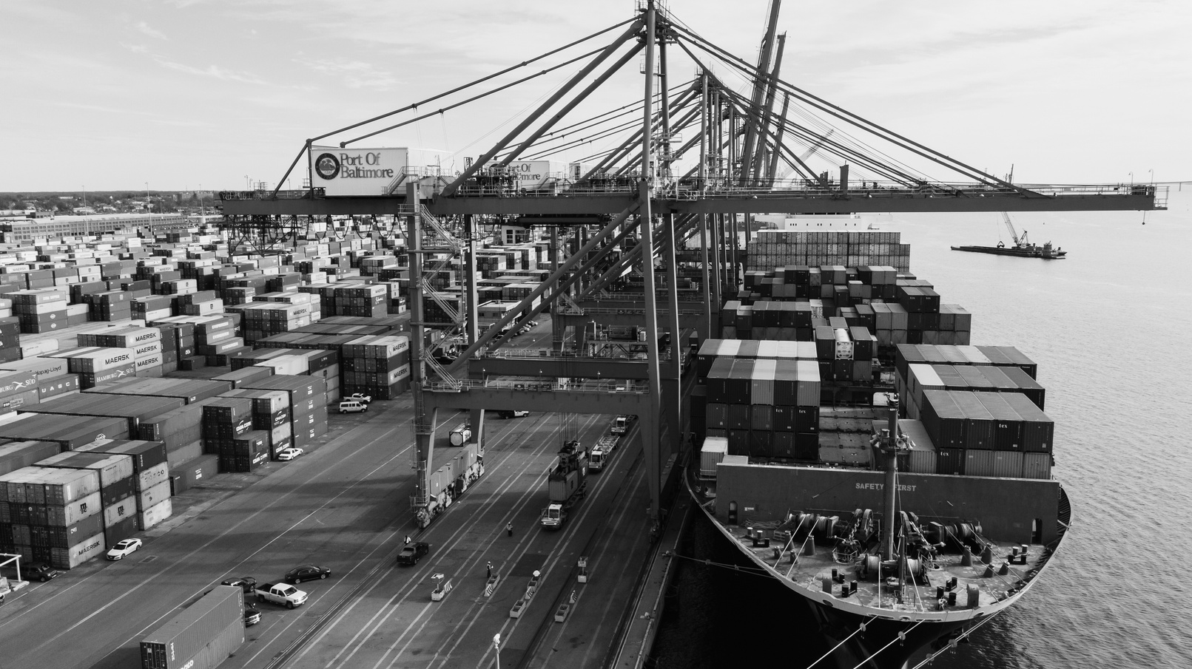
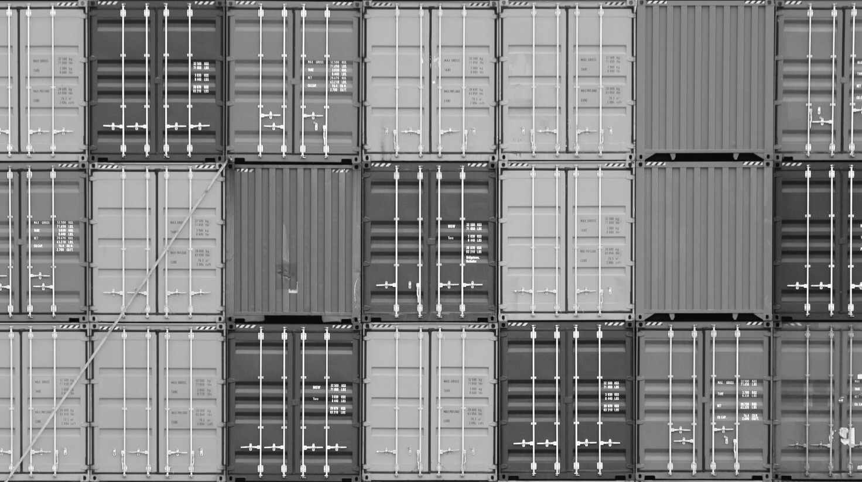
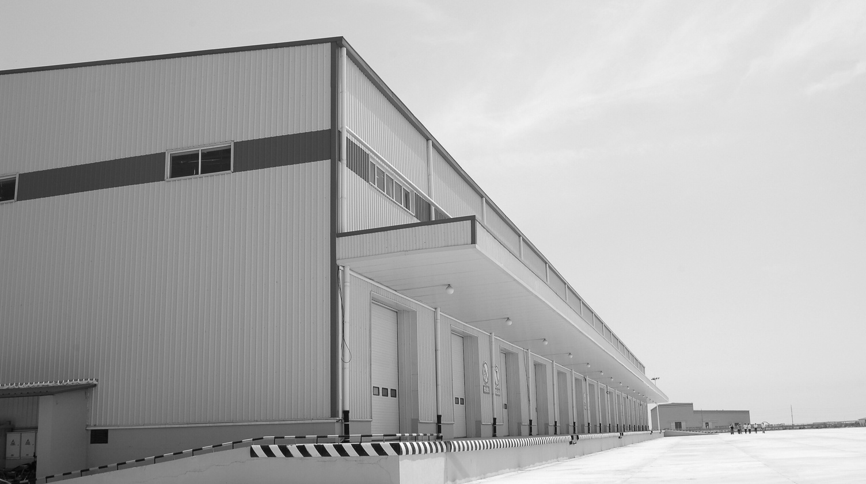
CBPA co-chairs the statewide group which focuses on
supply chain issues including ports and warehouses.

Slide 26
2024 EVENTS
Legislative All-Star Luncheon
February 22, 2024
Sacramento
Industrywide Legislative Zoom Meeting
March 22, 2024
CBPA Board Meeting & PAC Fundraiser
May 2, 2024
Downtown Los Angeles
CA Commercial Real Estate Summit
August 13-14, 2024
Sacramento
Industry Awards Dinner
November 7, 2024
Orange County
CBPA.COM

Slide 29
THANK YOU!
Matthew Hargrove, CEO
California Business Properties Association
mhargrove@cbpa.com

Slide 30
How A
Bill Becomes
Law
Who
Votes
When
LEGISLATIVE
101
How A Bill
REALLY
Becomes Law
Legislative Calendar

Slide 31
HOW A BILL
BECOMES LAW
State bill is
introduced
Committee Hearings
Committee
Hearings
Floor
Action
If passed (sent to other house)
Most bills become law January 1st of next year
If passed without amendments
Floor
Action
If passed with amendments
Referred to original house
If not vetoed
Bill goes to governor
If original
house concurs

Slide 32
HOW
A BILL
REALLY
BECOMES
LAW

Slide 33
POLITICAL
ACTION
COMMITTEES
P
A
C
PAY TO PLAY

Slide 34
SUPPORT & OPPOSITION
Who are our
“friends?”
California Business
Properties Association
BOMA California

Slide 35
LEGISLATIVE CALENDAR & DEADLINES
JAN. 3 - LEGISLATURE RECONVENES
JAN. 12 - LAST DAY FOR POLICY COMMITTEES TO HEAR AND REPORT TO FISCAL COMMITTEES FISCAL BILLS INTRODUCED IN THEIR HOUSE IN THE ODD-NUMBERED YEAR
JAN. 19 - LAST DAY FOR ANY COMMITTEE TO HEAR AND REPORT TO THE FLOOR BILLS INTRODUCED IN THAT HOUSE IN THE ODD-NUMBERED YEAR
FEB. 16 - LAST DAY FOR BILLS TO BE INTRODUCED
MAR. 21 - SPRING RECESS BEGINS UPON ADJOURNMENT OF THIS DAY’S SESSION
JUST TO NAME A FEW!

Slide 36
QUESTIONS?
Thank You!
Matthew Hargrove, CEO
California Business Properties Association
mhargrove@cbpa.com

